Slide 1
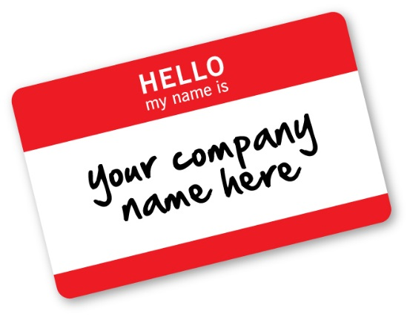
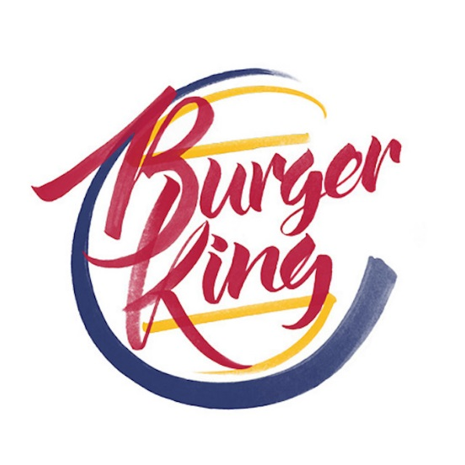
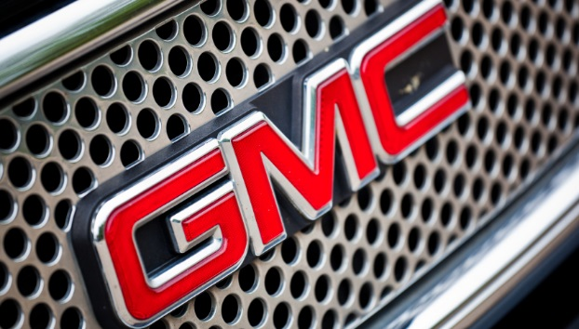
Branding Yourself

Slide 2
What is a Brand
A Brand includes the business name, logo, slogan, and mission statement associated with a business.
The goal of branding is to create a public perception.

Slide 3
Mission Statement
A mission statement is a statement of the company's purpose and reason for existing.
Mission statements often include the following information:
Key market – who is your target client/customer?
Contribution – what product or service do you provide to that client?
Distinction – what makes your product or service unique, so that the client would choose you?

Slide 4
For Example
McDonald's - "To provide the fast food customer food prepared in the same high-quality manner world-wide that has consistent taste, serving time, and price in a low-key décor and friendly atmosphere."
1. Key Market?
The fast food customer world-wide
2. Contribution?
Consistent taste and reasonably-priced food prepared in a high-quality manner
3. Distinction?
Delivered consistently (world-wide) in a low- key décor and friendly atmosphere.

Slide 5
For Example
At Tentree, our mission is to inspire a generation to create tangible change. The trees we plant have a tremendous impact across the planet often in impoverished communities, so were not only reviving the environment, were protecting people too

Slide 6
tentree
Key Market?
Contribution?
Distinction?

Slide 7
tentree
Key Market – Customers who want to create change
Contribution – plant trees for t-shirts bought across the planet often in impoverished communities
Distinction –reviving the environment and protecting people and the planet

Slide 8
For Example
Fog Off Clothing – “Our mission is to make a difference in the lives of those affected by a mental health disorder. This is accomplished by giving a voice along with a vessel to spread our message and fight the stigma.”

Slide 9
Fogoff
Key Market: People who want to spread the awareness and end the stigma around mental health disorders.
Contribution: Making a difference in the lives of those affected by mental health disorders
Distinction: Giving a voice along with a vessel to spread their message and helping to fight the stigma.

Slide 10
Brand Yourself
Branding is about lots more than logos and slogans
Branding is a critical part of your company’s success
A company’s brand is the experience it provides customers during the entire buying relationship
It’s about why your business exists, who it exists for and why you are different.

Slide 11
3 Steps To Create A Powerful Brand Branding means creating a strong identity and sharing it with customers in all their interactions with you.
Be Consistent – Develop core branding statements (a vision statement, your value proposition and a positioning statement), and reflect on them consistently in your activities and customer touch points.
Foster Community – Draw on your branding statements to identify your target market, recruit like-minded employees and create a community around your business.
Bring Your Brand To Life – Create content that reflects your vision and supports your brand
Taken from A Beauty Of A Brand
A Clearly Defined Brand Can Help You Score Big – By Alex Roslin

Slide 12
How can you come up with a good brand name?
BRAND YOURSELF. Before you name your business, you should have a handle on your niche. Define your goals in your business plan and mission statement.
A software company might want to emphasize the quality and simplicity of its products (Apple) while an accounting firm might want to emphasize its accuracy

Slide 13
Address your customer base. You need to understand what your customers are like and what they are looking for when they come to you.
If your target customers are wealthy you might want a name that caters to their upscale taste!
If your target customers are working moms who don’t have time to clean the house, you’ll want to consider a name that either recognizes their busy schedules, their desire for a clean house or both
Make lists of words that represent the qualities that you want to market.
Make a list of words that are specific to your business. “Rover” might be good if you plan to open a dog-walking business.

Slide 14
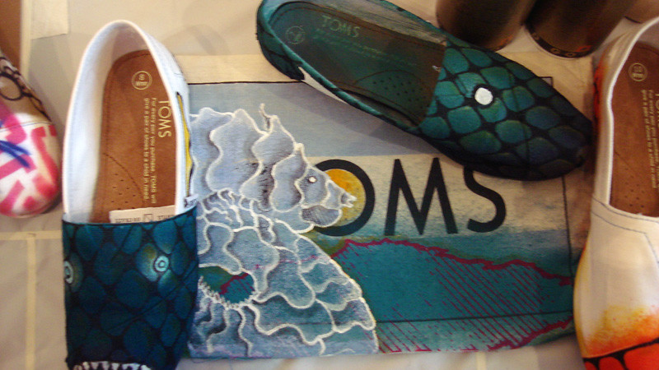
Try a simple one-word name. Tom’s emphasizes it personal nature whereas Timberland ‘s earthbound name reflects their product nicely.
Come up with some simple adjective-noun phrases. North Face and Black Cyprus are both evocative and versatile.
Try an “ing” word. This tends to make your business sound active and fun place with a welcoming atmosphere: “Laughing Planet”
Use a proper name as it can give a personal touch (ex: Papa John’s, Wendy’s)

Slide 15
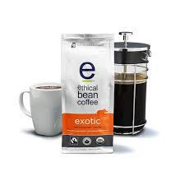
Make a new word! You are inventing a word, essentially, so it makes a lot of sense for entrepreneurial endeavors. Ex: Microsoft, Velcro, RedBull
Play with words
Use alliteration (Candy’s Crafts, Smith Sound, Yarns on York)
Rhyming (The Reel Deal, Yarn Barn)
Playing off a colloquial saying (Common Grounds and Ethical Bean) (coffee)
Making a historical, literary or mythological reference. “Starbucks,” after all, is named after a character in Moby Dick

Slide 16
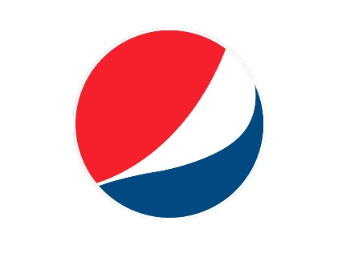
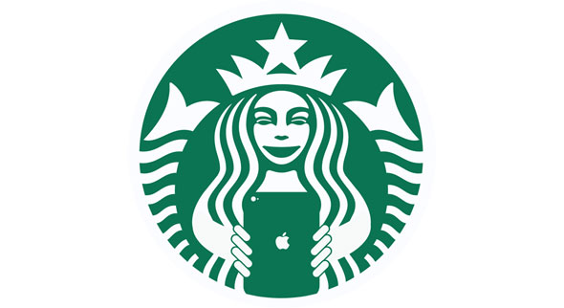
How to create a logo: with a well-designed logo, potential clients can instantly discover how your business can serve them. Do you know these?

Slide 17
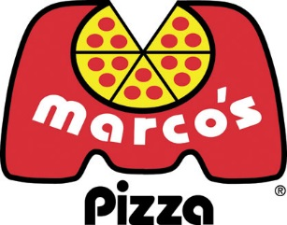
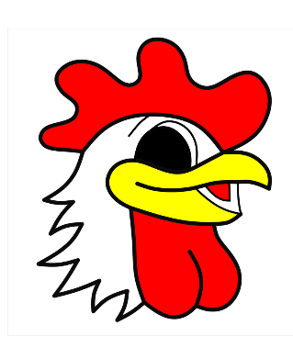
There are three types of logos:
Visual Symbols Illustrate what the company does
Monogrammatic which are Font-based
Abstract graphic

Slide 18
Your logo should mean something and not just be random. It should communicate something about your business.
Here’s how to get started!
Before you begin, articulate a message you want your logo to convey. Try writing a one sentence image and mission statement to help focus.

Slide 19
If this isn’t enough, here are some other tactics:
Look
Look at the logos of other businesses in your field.
Focus on
Focus on your message
Make
Make it clean and functional
Illustrate
Illustrate your business’s key benefit
Don’t use
Don’t use clip art
Avoid
Avoid trendy looks

Slide 20
Watch
Watch your colors.
Cost
Cost: many colors = more money when adding logo to things.
Do
Do a color study: look at logo in one, two- or three-color versions
Keep
Keep your color inline with your clientele.

Slide 21
Colour
Meaning
Red
Yellow
Green
Blue
Purple
Orange
Silver/gold/platinum
White
Black
danger/speed, heat, stop, assertive, exciting
warmth, happiness, welcoming, optimistic, weakness
freshness, environment, natural, clean
cool, tranquil, calm, stable, reserved
royalty, mysterious, quality, elite, discerning
friendly, youthful, social, accessible, affordable, playful
expensive, high quality, exclusive
purity, clean
exotic, mysterious, exclusive

Slide 22
Slogans
A slogan is a catchy phrase used to remind the consumer of a company or brand
The best slogans are:
Seven words or less
States the brand name
Catchy and memorable
How to create a tagline or slogan - Video

Slide 23
Alliteration Activity
Alliteration is often used in advertising for effect and recall. Harry’s Hamburgers is easier to remember than Cynthia’s Brachwurst. Just think how much easier it would be to remember names if first and last names started with the same initials.
Create a business with an alliteration that matches one or both or your names. (First and/or last) Marion’s Muscle Mowers, Carole’s Candles, Oscar’s Oranges.
Write your business name and a description of your business
Share with a partner, share with the class.

